Slide 1


Course Overview
EDPL 2005
Prior Learning Assessment: an 8-week course focused on individualized Credit for Prior Learning (iCPL)
Notes:
This presentation provides a course overview of the EDPL 2005 Prior Learning Assessment course, an 8-week course focused on individualized Credit for Prior Learning (iCPL).

Slide 2
Course Goals
During the term, you will learn about:
  experiential learning
  college level knowledge
  the process of creating credit requests for your prior experiential learning
  yourself as a learner
Goal by the end of the course:
  3 prior learning credit requests
Notes:
Let’s review the course goals. During the term, you will learn about the following: Experiential learning; College level knowledge; the process of creating credit requests for your prior experiential learning; and yourself as a learner.

Slide 3
What is Credit for Prior Learning (CPL)?
Getting credit for knowledge and skills acquired outside of traditional college coursework.
You can get credit from exams, evaluated professional learning, or individualized credit for prior learning (iCPL), the focus of this course.
To participate in iCPL, you document your learning in the form of credit requests which are assessed by expert evaluators.
Notes:
What is Credit for Prior Learning or CPL?
Getting credit for knowledge and skills acquired outside of traditional college coursework.
You can get credit from exams, evaluated professional learning, or individualized credit for prior learning, iCPL, the focus of this course.
To participate in iCPL, you document your learning in the form of credit requests which are then assessed by expert evaluators.

Slide 4
Assessing knowledge
This course will help you make tacit knowledge conscious so you can describe it and it can be assessed for university credit.
Tacit Knowledge: | Conscious Knowledge:
Knowledge gained through experience or that you know “in your bones” but don’t know how to explain | Knowledge that you are aware of and can easily explain
Notes:
In the course, you will be introduced to concepts related to documenting your learning and assessing your knowledge. Two concepts that you will become more familiar with are tacit and conscious knowledge.

Slide 5

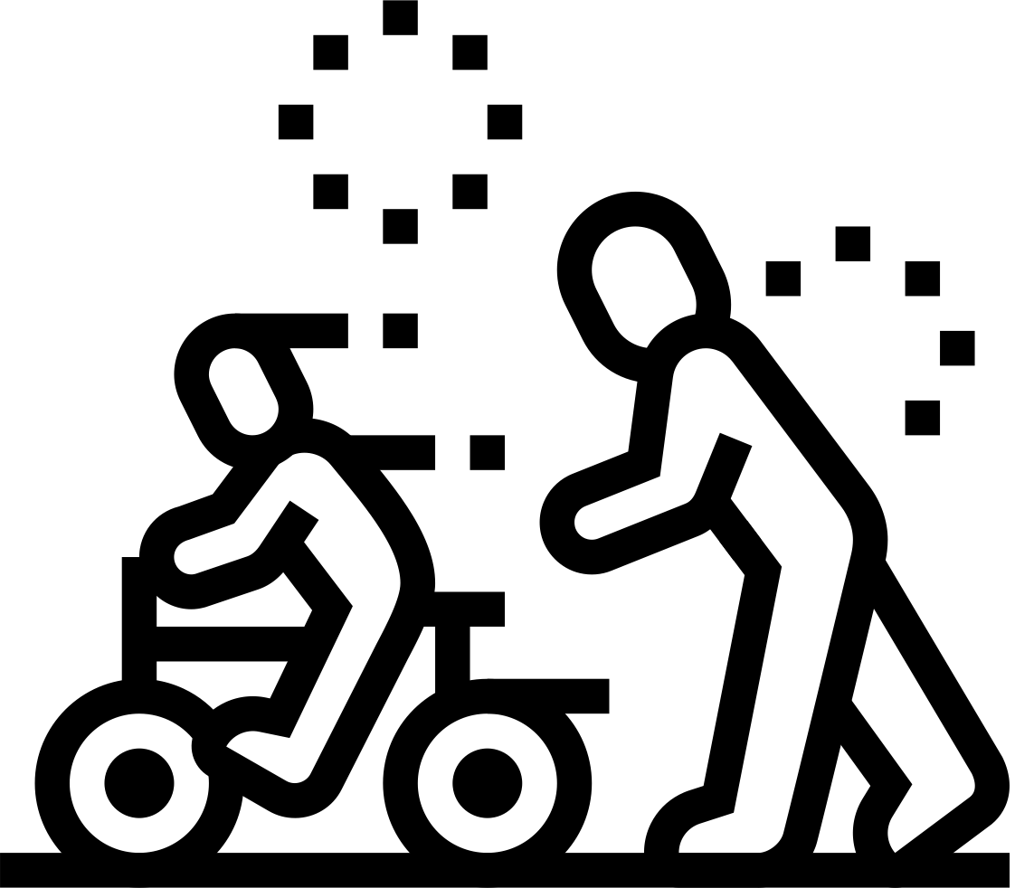

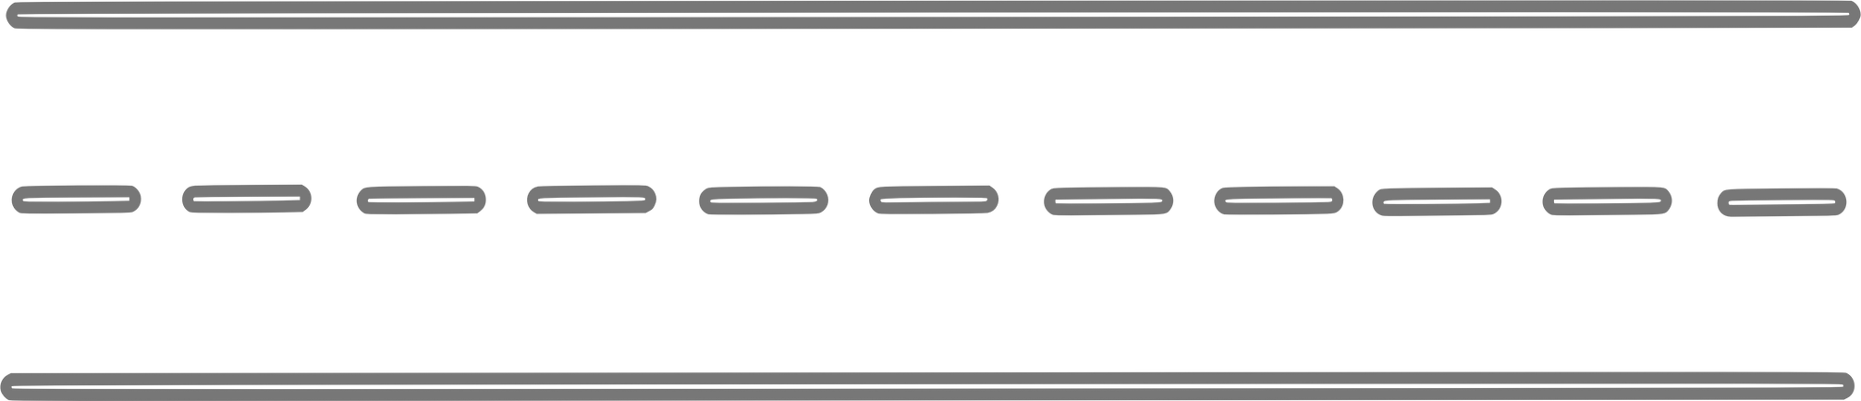
Example:
Making Tacit Knowledge Conscious - what you will be doing in this course:
You may know how to ride a bicycle, but you may not know what you’re doing to keep the bike upright.
Notes:
Let’s review an example of making tacit knowledge conscious which is what you will be doing in this course.
You may know how to ride a bicycle, but you may not know what you’re doing to keep the bike upright.

Slide 6
You will engage in:
Questioning - “How do I keep the bike upright?”
Reflection - Taking time to reflect on your own and with others to try to describe what you know
Analyzing - Using the bike example, you may discover that the following abilities help you to ride your bike:
    Ability to balance
    Steer
    Pedal
    Do the above simultaneously
Documenting- gathering and recording information and evidence to support your learning
Notes:
You will engage in the following processes in this course…
One, Questioning – Using the bike example, you might ask: “How do I keep the bike upright?”
Two, Reflection – taking time to reflect on your own and with others to try to describe what you know.
Three, Analyzing – Using the bike example, you may discover that through analyzing, that the following abilities will help you to ride your bike: ability to balance; steer; pedal; and do the above simultaneously.
And finally, Documenting – gathering and recording information and evidence to support your learning.

Slide 7
Overview of Course Modules
EDPL 2005: COURSE
1
CPLConcepts & Processes
5
Draft iCPL
request #2
Prior Learning Assessment
Introductory, 2 credits
2
Define college-level knowledge
6
Discuss drafts,
revise & finalize
iCPL#2
  8-Week course
  Focus on Individualized Credit for Prior Learning (iCPL)
  Develop 3 iCPL requests
  Remaining requests developed with the mentor/advisor
3
Draft iCPL
request #1
7
Create iCPL#3
or alternative assignment
4
Discuss drafts, revise & finalize
iCPL#1
8
Reflections & next steps
Notes:
Let’s review some aspects of the course.
The Prior Learning Assessment course is an 8-week course that focuses on individualized Credit for Prior Learning or iCPL.
As a student in this course, you will develop 3 iCPL requests and any remaining requests needed are developed with the student’s mentor/advisor.
Each Module in the course is a week- long. As you can see in the Overview of the Course Modules, the first iCPL request is not drafted until Module 3 to give you ample time to learn about CPL and college level knowledge as well as reflect on your learning in the first two weeks.
You will have an opportunity to receive feedback on your draft from peers and the course instructor so that you may finalize the iCPL #1 assignment for submission in Module 4.
In Module 5 you will draft your second iCPL request and revise and refine in Module 6 based on feedback.
In Module 7 you will develop your third iCPL request or, if you have determined that you have just 2 viable requests, complete an alternative assignment in lieu of the third iCPL request.
In week 8 you will reflect on your learning in the course and learn about next steps beyond the course to formalize the requests with your mentor/advisor.
It is important to note that in addition to the three iCPL assignments, there are learning activities and discussion assignments that will help you to reflect on your learning and prepare the requests. Please refer to the syllabus and course schedule for specific information about all learning activities.

Slide 8

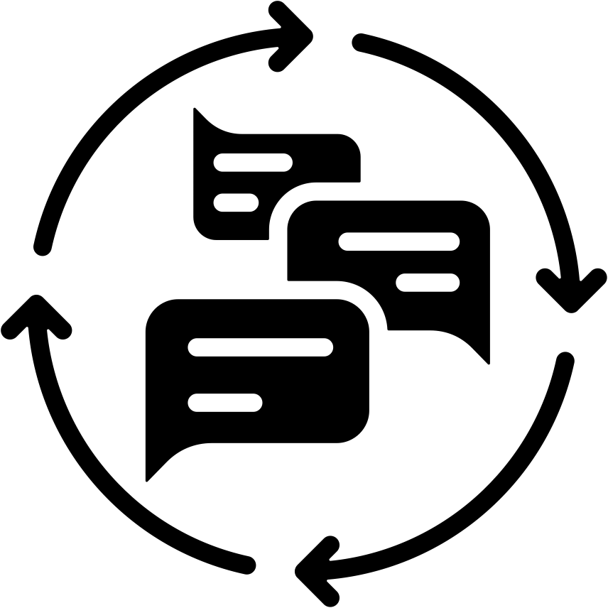

How to be successful in this course
Review the syllabus and course information.
Read & apply the feedback from your instructor who has served in the evaluator role and will help you to present your experiential knowledge in the strongest and clearest way.
Give yourself adequate time to think about and reflect on your learning to maximize chances for success.
Notes:
Reviewing the syllabus and course information is important to do in order to understand the course and to be successful in this course.
Other ways to be successful in this course include: taking the time to read and apply the feedback from your instructor who has served in the evaluator role and will help you to present your experiential knowledge in the strongest and clearest way.
In addition, give yourself adequate time to think about and reflect on your learning to maximize chances for success.

Slide 9







Skills supported in this course
Learning/Assessing Learning
Critical Thinking
Mindset
Identifying Competencies
Writing/Revision Skills
Academic
Skills
Peer Assessment
Affirming value of
prior learning
Notes:
As a student in this course, you will learn or fine-tune many skills which are transferable to future academic work or your personal and professional life:
Some of these skills include: critical thinking; writing /revision skills; giving and receiving peer feedback; learning about learning and how to assess learning; identifying competencies and affirming the value of prior learning.
Listen to what some students have had to say about the course in their final reflection which informed a new Mindset:
“As a learner, I do best when I talk things out first in a rough way and then edit later...writing about my work made me more confident because I’ve actually done a lot , even though I never really thought it as “college level” until now.”
AND…
“It challenged me to engage in significant critical reflection to articulate the distinction between tasks simply “done” and the deeper learning acquired over my working life.”
In conclusion, the course provides both a structured learning environment to learn about iCPL in addition to building skills and competencies needed to confidently articulate your prior learning. The benefits gained support academic success, a self-awareness mindset and professional growth.

