Slide 1


Course Overview
EDPL 2005
Prior Learning Assessment:
an 8-week course focused on
individualized Credit for Prior Learning (iCPL)

Slide 2
Course Goals
During the term, you will learn about:
  experiential learning
  college level knowledge
  the process of creating credit requests for your prior experiential learning
  yourself as a learner
Goal by the end of the course:
  3 prior learning credit requests

Slide 3
What is Credit for Prior Learning (CPL)?
  Getting credit for knowledge and skills acquired outside of traditional college coursework.
  You can get credit from exams, evaluated professional learning, or individualized credit for prior learning (iCPL), the focus of this course.
  To participate in iCPL, you document your learning in the form of credit requests which are assessed by expert evaluators.

Slide 4
Assessing knowledge....
This course will help you make tacit knowledge conscious so you can describe it and it can be assessed for university credit.
Tacit Knowledge:
Conscious Knowledge:
Knowledge gained through experience or that you know “in your bones” but don’t know how to explain
Knowledge that you are aware of and can easily explain

Slide 5



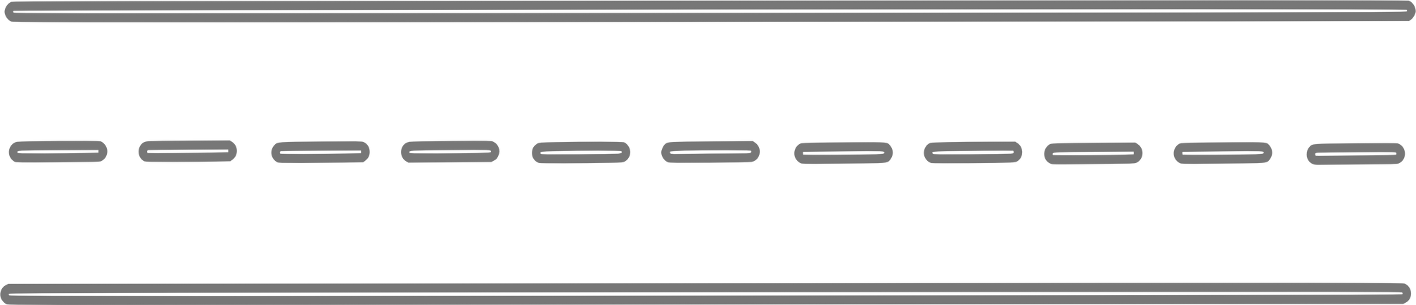
Example:
Making Tacit Knowledge Conscious - what you will be doing in this course:
You may know how to ride a bicycle, but you may not know what you’re doing to keep the bike upright.

Slide 6
You will engage in the following...
1. Questioning - “How do I keep the bike upright?”
2. Reflection - Taking time to reflect on your own and with others to try to describe what you know
3. Analyzing - Using the bike example, you may discover that the following abilities help you to ride your bike:
  Ability to balance
  Steer
  Pedal
  Do the above simultaneously
4. Documenting- gathering and recording information and evidence to support your learning

Slide 7
Overview of Course Modules
EDPL 2005: COURSE
1
CPLConcepts & Processes
5
Draft iCPL
request #2
Prior Learning Assessment
Introductory, 2 credits
  8-Week course
  Focus on Individualized Credit for Prior Learning (iCPL)
  Develop 3 iCPL requests
  Remaining requests developed with the mentor/advisor
2
Define college-level knowledge
6
Discuss drafts,
revise & finalize
iCPL#2
3
Draft iCPL
request #1
7
Create iCPL#3
or alternative assignment
4
Discuss drafts, revise & finalize
iCPL#1
8
Reflections & next steps

Slide 8

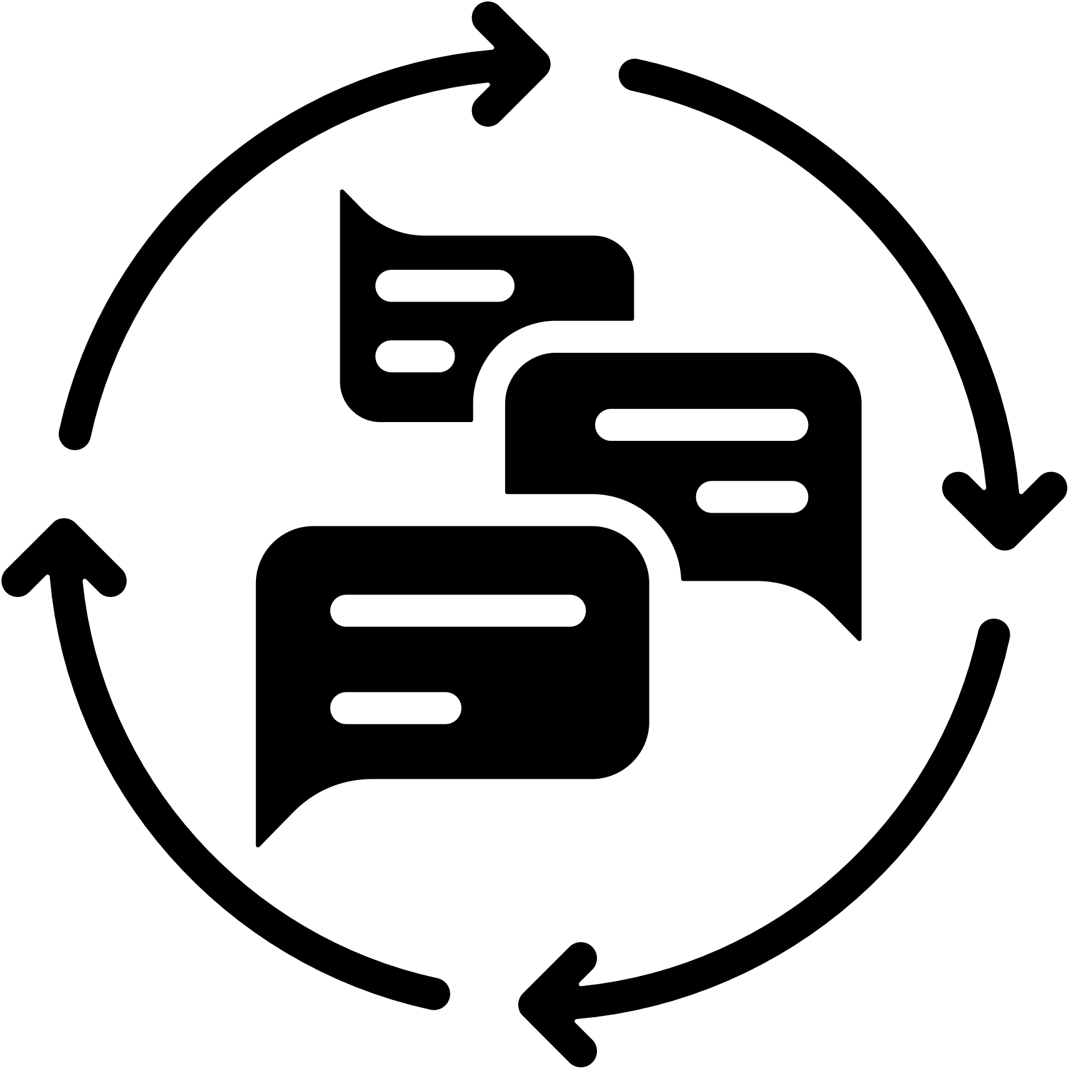

How to be successful in this course
Review the syllabus and course information.
Read & apply the feedback from your instructor who has served in the evaluator role and will help you to present your experiential knowledge in the strongest and clearest way.
Give yourself adequate time to think about and reflect on your learning to maximize chances for success.

Slide 9







Skills supported in this course.....
Learning/Assessing Learning
Critical Thinking
Mindset
Identifying Competencies
Writing/Revision Skills
Academic
Skills
Peer Assessment
Affirming value of
prior learning

